Slide 1
NDFD Weather Element (“ugly string”) Verification
Paul Fajman
NOAA/NWS/MDL
September 7, 2011

Slide 2
Table of Contents
NDFD ugly string
NDFD Forecasts and encoding
Observations
Assumptions
Output, Scores and Display
Results
Future Work

Slide 3
What is an ugly string?
Weather element has 5 parts:
Coverage/Probability
Weather Type
Intensity
Visibility
Attributes
Combine those 5 parts to form the ugly string
Sample Weather String | Meaning
<NoCov>:<NoWx>:<NoInten>:<NoVis>: | No Weather
Def:R:+:4SM: | Definite heavy rain, visibility at 4 statute miles
Lkly:S:m:<NoVis>:^Chc:ZR:-:<NoVis>: ^Chc:IP:-:<NoVis>: ^Areas:BS:<NoInten>:<NoVis>: | Likely moderate snow, chance light freezing rain, chance light ice pellets, areas of blowing snow

Slide 4
NDFD Forecasts
Forecasts produced on a 5 km grid
Extract data (using degrib) at points where there are METAR stations.
Very specific list of points which have been approved by WFOs
At this time, only points are being verified
NDFD forecasts can be updated every hour.
Forecasts are valid from the top of the hour until 59 minutes past the hour.

Slide 5
Forecast Encoding
Notes:
Only concerned with the first 2 pieces of the ugly string. In the future, visibility or intensity could be incorporated.

Slide 6
Observations
The forecasts are verified with METAR observations that occur at the top of the hour.
There are up to 3 independent weather types reported
Verify weather types 206-213 and 215-223
Thunderstorms are verified with METAR observations and the 20km convective predictand dataset (Charba and Samplatsky) which is a combination of radar data and NLDN.
Observations are reported over a one hour range
Notes:
Hourly edited observations
40dBZ for convective dataset

Slide 7
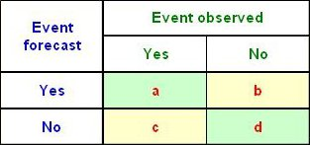
Verification
Ignored
Notes:
Showing this slide before the assumptions so that audience will be familiar with terms used in the assumption section.

Slide 8
Assumptions
Forecasts
1. Forecasts that fall within a chosen probability range and their corresponding observations are used in the computation of the threat score.
2. Observations that have a corresponding valid forecast and were missed will count as both a false alarm and a miss. For example, if snow was forecasted and rain was observed, the event would be counted as a false alarm for the snow forecast and a miss for the rain.
3. Frost, freezing spray, water spouts, and snow grain forecasts were considered no weather forecasts.
Notes:
Not all observation are scored. If an observation doesn’t have a forecast in that chosen probability range, then it is ignored. Meaning in the end, a lot of observations can be missed.
Double penalty for a false alarm and missing another type of event.

Slide 9
Assumptions
Constrained by what is reported in the METARs and how those data are processed
Observations
1. Multiple weather types can verify various forecast precipitation types. Rain verifies rain, rain shower, and drizzle forecasts and so on.
2. Unknown precipitation verifies rain, rain shower, drizzle, snow, snow shower, ice pellet, freezing rain, and freezing drizzle forecasts.
3. All fog forecasts (normal, freezing, and ice) are verified by any fog observation.
4. Blowing dust or sand forecasts are verified by any observation of blowing dust or sand.
Notes:
Hourly edited observations

Slide 10
Assumptions
Observations
5. Observations reported to be within sight of the observation location do not verify a forecast as a hit. (e.g. 40 = VCFG Fog between 5-10 miles from the station.)
6. Dust, mist, spray, tornado, and blowing spray are considered no weather observations.
7. If a forecast is considered a false alarm, the observation is not always considered a miss. No weather and unknown precipitation observations are not counted as misses.
8. When the coded observation is ambiguous, only the most likely precipitation type is considered the missed observation. In most cases, this applies to coded observations 68 (light rain/snow/drizzle mix) and 69 (moderate or heavy mix).

Slide 11
The Script
Default setting: Analyze entire month of data for both the 00Z and 12Z cycle, for all locations, for all forecast projections, using all weather strings (except NoWx forecasts) outputting the results for each cycle and forecast projection.
In manual mode, a user can control these forecast parameters:
weather (ugly) string
cycle
date range
coverage/probability groups
forecast projection hours
locations (Region, WFO, or multiple stations)

Slide 12
Output
Location CSI Cases
CSI for CONUS and Regions heads the output
Followed by individual station and WFO data.
At the bottom of text file, individual weather element statistics are printed.
WxElement Hits False Alarms Misses
Total 500 200 50
Rain 200 150 25
Snow 200 25 20
Fog 100 25 5

Slide 13
Displaying the Output
Knowing the Hits, False Alarms, and Misses, four quality measures can be calculated:
Probability of Detection (POD) = A/(A+C)
False Alarm Ratio (FAR) = B/(A+B)
Bias = (A+B)/(A+C)
CSI = A/(A+B+C)
These commonly used measures are mathematically related and can be geometrically represented on the same diagram.

Slide 14
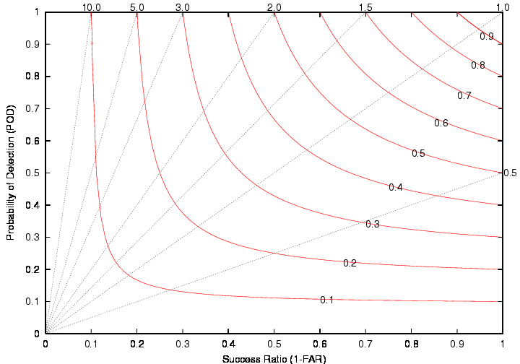
Displaying the Output
Overforecast
Never Miss
Skillful
BIAS
Many
False
Alarms
No
False
Alarms
CSI
http://journals.ametsoc.org/doi/pdf/10.1175/2008WAF2222159.1
Not Skillful
Underforecast
Always Miss

Slide 15
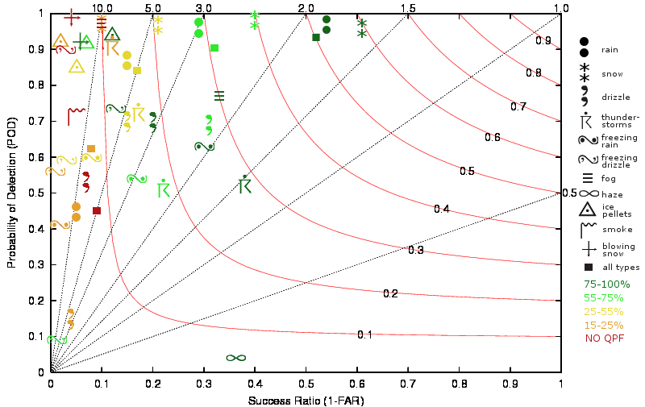
Results (Cool Season Jan-Mar/2010 and Oct-Dec/2010)
Notes:
Here I wanted to highlight the standard precipitation types. (Rain, snow, and thunderstorms)

Slide 16
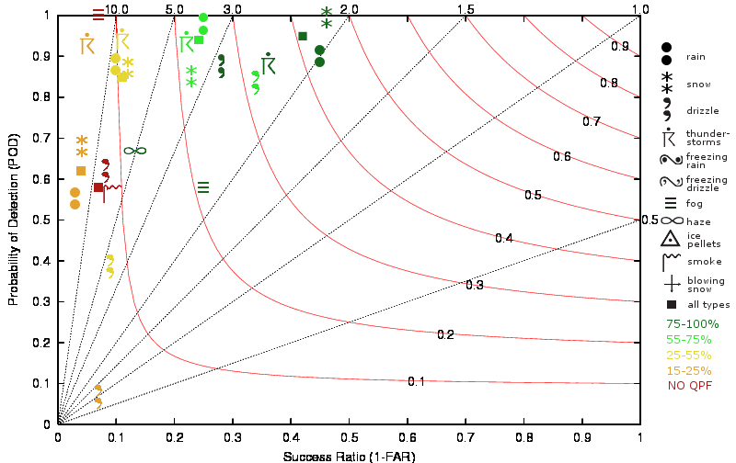
Results (Warm Season Apr – Aug 2010)
Notes:
Here I wanted to highlight the standard precipitation types. (Rain, snow, and thunderstorms)

Slide 17
Results
Thunderstorm forecast scores improved considerably with convective observations
Cool season had higher CSI for all probability groups.
Warm season had more cases in every prob group, except 75-100% and non-QPF probabilities.
Rarer events (freezing rain, freezing drizzle, ice pellets) don’t verify very well at any probability group.

Slide 18
Future Work
Verify GMOS at points
Compare GMOS vs. NDFD
Add ability to handle a matched sample of cases for any number of forecast sources
Add POD and FAR to text output.
Automate the entire process from data ingest to production of plots.
Verify more seasons

Slide 19
QUESTIONS?

Slide 20
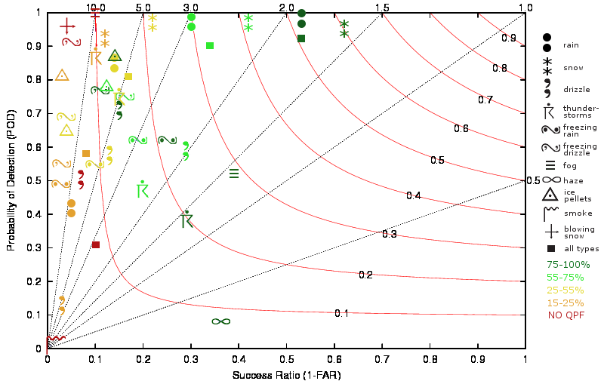
Cool Season 00Z
Cool Season 12Z

Slide 21
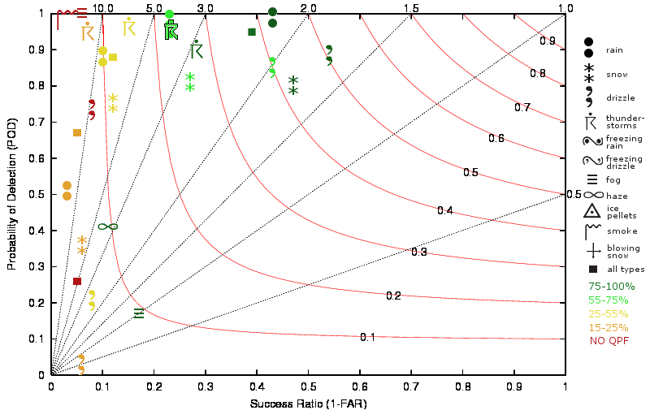
Warm Season 00Z
Warm Season 12Z

